Slide 1
Time Series Analysis

Slide 2
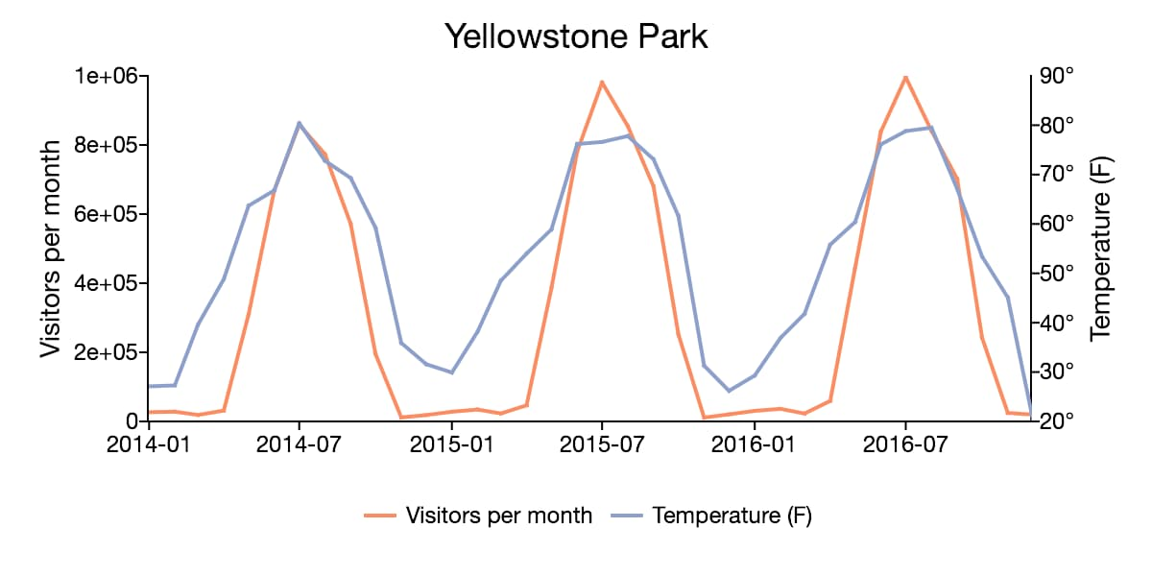
Introduction
Time series analysis is a specific way of analyzing a sequence of data points collected over an interval of time. In time series analysis, analysts record data points at consistent intervals over a set period of time rather than just recording them.
Time series analysis helps organizations understand the underlying causes of trends or systemic patterns over time. Using data visualizations, business users can see seasonal trends and dig deeper into why these trends occur data points intermittently or randomly.

Slide 3
Applications of Time Series Analysis
Weather data
Rainfall measurements
Temperature readings
Heart rate monitoring (EKG)
Brain monitoring (EEG)
Quarterly sales
Stock prices
Automated stock trading
Industry forecasts
Interest rates

Slide 4
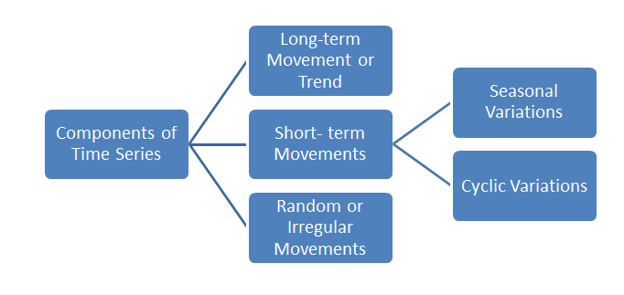
Components for Time Series Analysis

Slide 5
Trend
The trend shows the general tendency of the data to increase or decrease during a long period of time. A trend is a smooth, general, long-term, average tendency. It is not always necessary that the increase or decrease is in the same direction throughout the given period of time.
Linear and Non-Linear Trend
If we plot the time series values on a graph in accordance with time t. The pattern of the data clustering shows the type of trend. If the set of data cluster more or less round a straight line, then the trend is linear otherwise it is non-linear (Curvilinear).

Slide 6
Periodic Fluctuations
There are some components in a time series which tend to repeat themselves over a certain period of time. They act in a regular spasmodic manner.
Seasonal Variations
These are the rhythmic forces which operate in a regular and periodic manner over a span of less than a year. They have the same or almost the same pattern during a period of 12 months. This variation will be present in a time series if the data are recorded hourly, daily, weekly, quarterly, or monthly.
Cyclic Variations
The variations in a time series which operate themselves over a span of more than one year are the cyclic variations.

Slide 7
Random or Irregular Movements
There is another factor which causes the variation in the variable under study. They are not regular variations and are purely random or irregular. These fluctuations are unforeseen, uncontrollable, unpredictable, and are erratic. These forces are earthquakes, wars, flood, famines, and any other disasters.

Slide 8
Mathematical Model for Time Series Analysis
Mathematically, a time series is given as
y_{t} = f (t)
Here, y_{t} is the value of the variable under study at time t. If the population is the variable under study at the various time period t₁, t₂, t₃, … , t_{n}. Then the time series is
t: t₁, t₂, t₃, … , t_{n}
y_{t}: y_{t1}, y_{t2}, y_{t3}, …, y_{tn}

Slide 9
Additive Model for Time Series Analysis
If y_{t} is the time series value at time t. T_{t}, S_{t}, C_{t}, and I_{t} are the trend value, seasonal, cyclic and random fluctuations at time t respectively. According to the Additive Model, a time series can be expressed as
Let Y= original observation, T= trend component, S=seasonal component, C=cyclical component, and I=irregular component.
It is assumed that the value Y of a composite series is the sum of the four components.
yt = Tt + St + Ct + It.
This model assumes that all four components of the time series act independently of each other.

Slide 10
Multiplicative Model for Time Series Analysis
The multiplicative model assumes that the various components in a time series operate proportionately to each other. According to this model.
It is assumed that the value Y of a composite series is the product of the four components.
y_{t} = T_{t} × S_{t} × C_{t} × I_{t}

Slide 11
Mixed Models
Different assumptions lead to different combinations of additive and multiplicative models as
y_{t} = T_{t} + S_{t} + C_{t} +I_{t.}
The time series analysis can also be done using the model
y_{t} = T_{t} + S_{t} × C_{t} × I_{t} or y_{t} = T_{t} × C_{t} + S_{t} × I_{t} etc.

Slide 12
Time Series Analysis Methods
Graphical Method
Moving Average Method
Least Square Method

Slide 13
Graphical Method
Year | Y
1999 | 19.3
2000 | 20.9
2001 | 17.8
2002 | 16.1
2003 | 17.6
2004 | 17.8
2005 | 18.3
2006 | 17.3
2007 | 21.4
2008 | 19.3

Slide 14
Moving Average Method
One method of establishing the underlying trend (smoothing out peaks and troughs) in a set of data is using the moving averages technique. Other methods, such as regression analysis can also be used to estimate the trend.
A moving average is a series of averages, calculated from historic data. Moving averages can be calculated for any number of time periods, for example a three-month moving average, a seven-day moving average, or a four-quarter moving average.

Slide 15
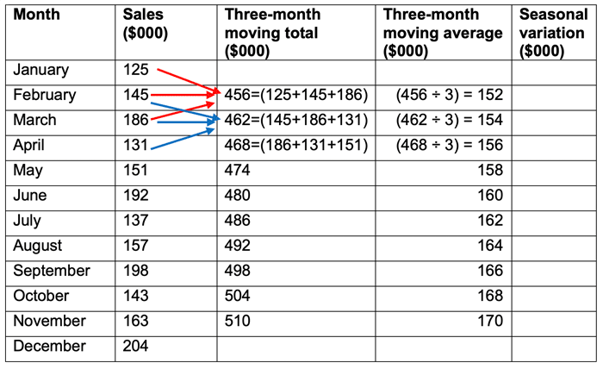

Slide 16
Moving Average Method
Calculate the trend:
The three-month moving average represents the trend. From our example we can see a clear trend in that each moving average is $2,000 higher than the preceding month moving average. This suggests that the sales revenue for the company is, on average, growing at a rate of $2,000 per month.

Slide 17
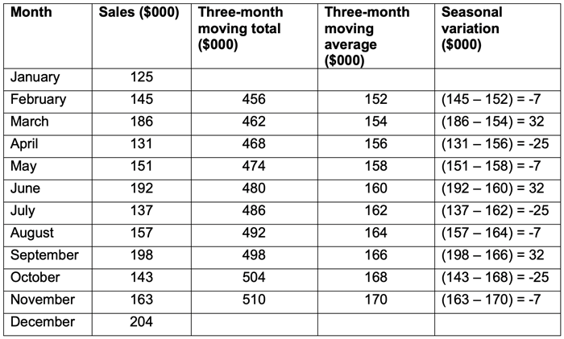
Moving Average Method
Calculate the seasonal variation:
Once a trend has been established, any seasonal variation can be calculated. The seasonal variation can be assumed to be the difference between the actual sales and the trend (three-month moving average) value. Seasonal variations can be calculated using the additive or multiplicative models.

Slide 18
Moving Average Method
From the data we can see a clear three-month cycle in the seasonal variation. Every first month has a variation of -7, suggesting that this month is usually $7,000 below the average. Every second month has a variation of 32 suggesting that this month is usually $32,000 above the average. In month 3, the variation suggests that every third month, the actual will be $25,000 below the average.

Slide 19
Least Square Method
The least-squares principle says that “the sum of squares of the deviations of the observed values from the corresponding expected values should be least”. Among all the trend lines, the trend line is called a least-squares fit for which the sum of the squares of the deviations of the observed values form their corresponding expected values is the least.
Year | Sales | x=x-a | x² | xy | Y=a+bx
2015 | 30 | -2 | 4 | -60 | 45
2016 | 50 | -1 | 1 | -50 | 50
2017 | 75 | 0 | 0 | 0 | 55
2018 | 80 | 1 | 1 | 80 | 60
2019 | 40 | 2 | 4 | 80 | 65
N=5 | ∑y=275 |  | ∑x²=10 | ∑xy=50

Slide 20
Rule Induction
1. Rule induction is a data mining process of deducing if-then rules from a dataset.
2. These symbolic decision rules explain an inherent relationship between
the attributes and class labels in the dataset.
3. Many real-life experiences are based on intuitive rule induction.
4. Rule induction provides a powerful classification approach that can be easily understood by the general users.
5. It is used in predictive analytics by classification of unknown data.
6. Rule induction is also used to describe the patterns in the data.
7. The easiest way to extract rules from a data set is from a decision tree that is developed on the same data set.

Slide 21
Procedure of Extracting Rules
Step 1 : Class selection :
a. The algorithm starts with selection of class labels one by one.
b. The rule set is class-ordered where all the rules for a class are developed before moving on to next class.
c. The first class is usually the least-frequent class label.
d. From Fig. 1, the least frequent class is “+” and the algorithm focuses on generating all the rules for “+” class.
+ - + - - --
+ + + - - -
- - -- - - + +
------ -- +++

Slide 22
Procedure of Extracting Rules
Step 2: Rule development :
a. The objective in this step is to cover all “+” data points using classification rules with none or as few “–” as possible.
b. For example, in Fig. 2.10.2 , rule r1 identifies the area of four “+” in the top left corner.
C. Since this rule is based on simple logic operators in conjuncts, the boundary is rectilinear.
d. Once rule r1 is formed, the entire data points covered by r1 are eliminated and the next best rule is found from data sets.
+ Rule1(r) --
+ + - - -
- - -- - - + +
------ -- +++
+ + + +

Slide 23
Procedure of Extracting Rules
Step 3 : Learn-One-Rule :
a. Each rule r1 is grown by the learn-one-rule approach.
b. Each rule starts with an empty rule set and conjuncts are added one by one to increase the rule accuracy.
c. Rule accuracy is the ratio of amount of “+” covered by the rule to all
records covered by the rule :
d. Learn-one-rule starts with an empty rule set: if {} then class = “+”.
e. The accuracy of this rule is the same as the proportion of + data points in the data set. Then the algorithm greedily adds conjuncts until the accuracy reaches 100 %.
f. If the addition of a conjunct decreases the accuracy, then the algorithm looks for other conjuncts or stops and starts the iteration of the next rule.

Slide 24
Procedure of Extracting Rules
Step 4 : Next rule :
a. After a rule is developed, then all the data points covered by the
rule are eliminated from the data set.
b. The above steps are repeated for the next rule to cover the rest of the “+” data points.
c. In Fig. 2.10.3, rule r2 is developed after the data points covered by r1 are eliminated.
+ --
Rule2(r)
- - -- - - + +
------ -- +++
Rule1(r)
+ + + ++

Slide 25
Procedure of Extracting Rules
Step 5 : Development of rule set :
a. After the rule set is developed to identify all “+” data points, the rule model is evaluated with a data set used for pruning to reduce generalization errors.
b. The metric used to evaluate the need for pruning is (p – n)/(p + n), where p is the number of positive records covered by the rule and n is the number of negative records covered by the rule.
c. All rules to identify “+” data points are aggregated to form a rule
group.

